Slide 1
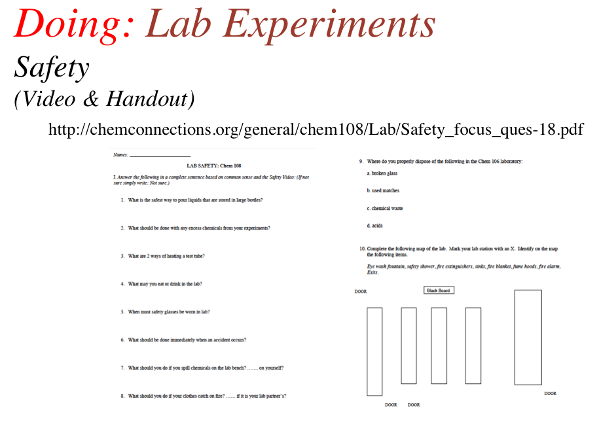
Chem 108: Lab
Sign in: Roster @ front of lab
Open Lab Drawer
Select a partner to work with
for today’s lab experiment
Turn in:
completed safety handout before beginning experiment.

Slide 2
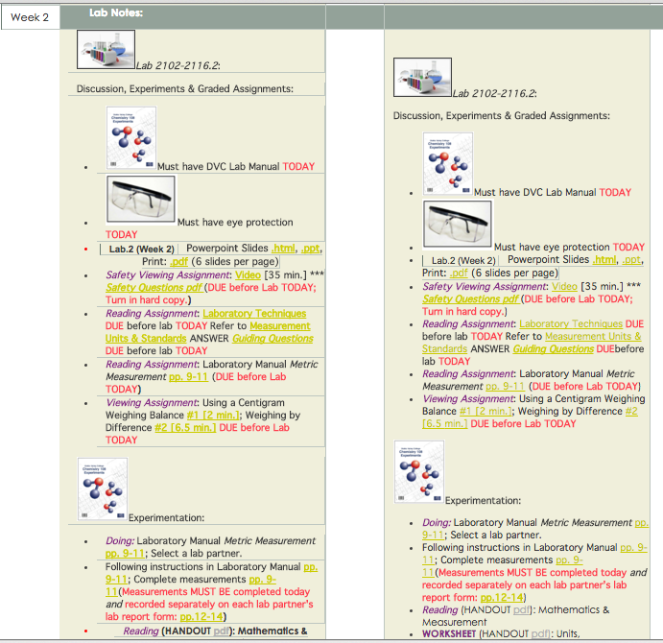
http://chemconnections.org/general/chem108/calendar-108-s19.html
Monday Wednesday
CHEM 108

Slide 3
Question
The title of today’s experiment is:
Measurement of the Properties of Gases
Metal Measurement
Measuring the Energy of Combustion
Metric Measurement
Measuring the Calories in a Can of Coca Cola

Slide 4
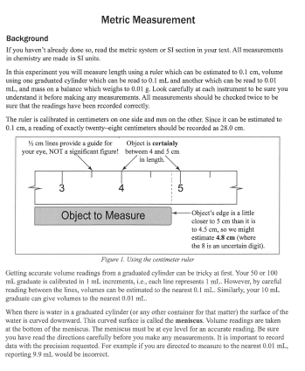
Answer D.
Experiment 1 – Metric Measurement

Slide 5
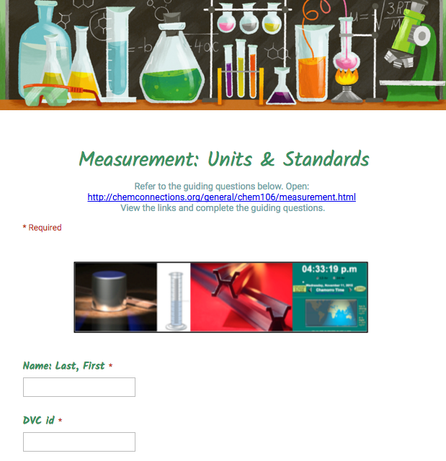
Doing: Lab Experiments
Metric Measurement [Experiment #1]
Background & Preparation [Graded Guiding Questions]
http://chemconnections.org/general/chem108/Measurements.Units-Guide.html

Slide 6
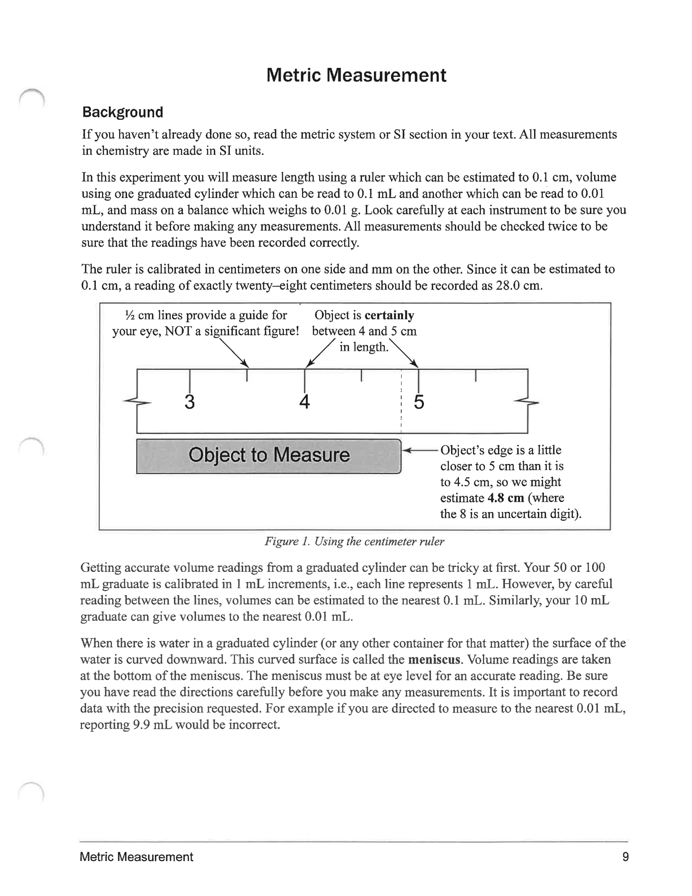
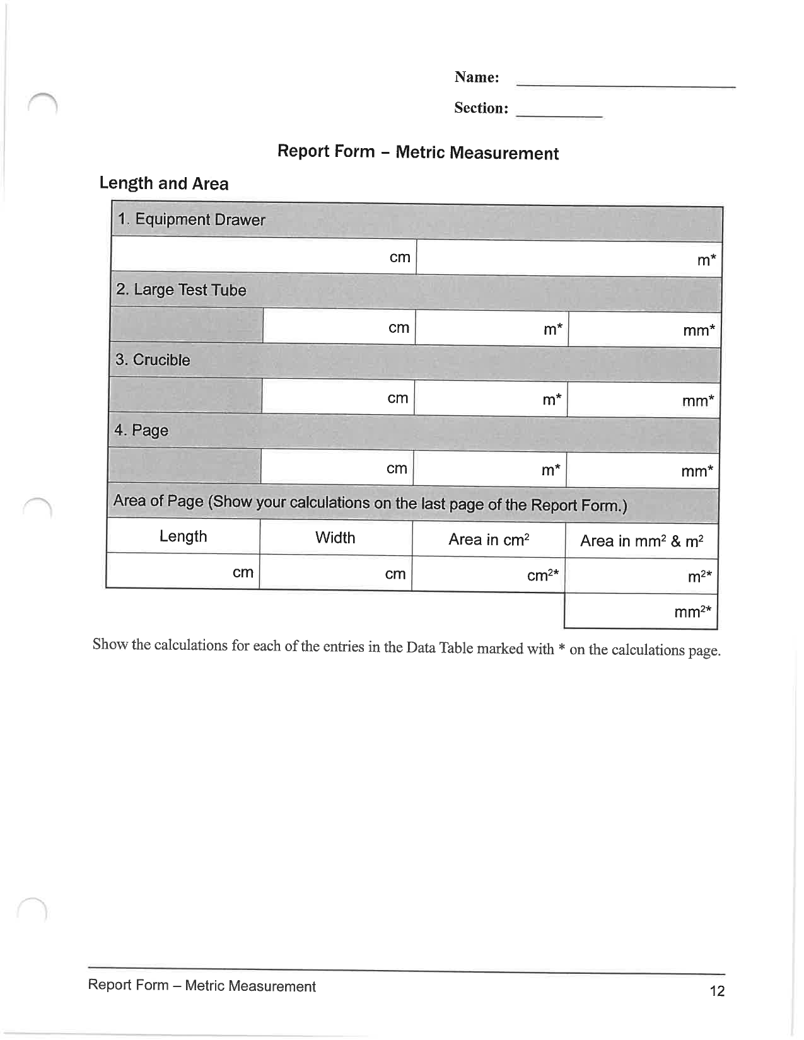
Doing: Lab Experiments
Metric Measurement [Experiment #1]
(Course/ Lab Manual pp. 9-11; pp. 12-15 [Report Form])
http://chemconnections.org/general/chem108/calendar-108-f18.html
Collaboration is encouraged, but individual record keeping and submissions are required. MUST use Lab Manual pages for record keeping. Black or blue ink preferred without erasures, but pencil OK for Chem 108.

Slide 7


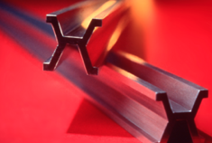
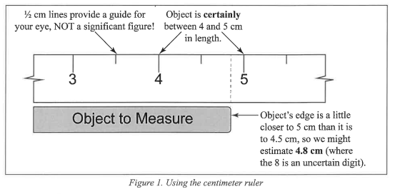
Doing: Lab Experiments
Metric Measurement [Experiment #1]
(Course/ Lab Manual pp. 9-11; pp. 12-15 [Report Form])

Slide 8
Exp. 1 – Metric Measurement
Goal: Using instruments having different levels of precision, make accurate measurements of length, area, volume, and mass
Convert measurements to different units using Dimensional Analysis

Slide 9
Exp. 1 – Metric Measurement
Work with a partner
  Keep separate records. On each partner’s Lab REPORT FORM, write your name first & then your partner’s in (____)
S. Curry (D. Green)
and on your partner’s form
D. Green (S. Curry)

Slide 10
Exp. 1 – Metric Measurement
  Do each measurement separately and independently. Then, compare your value with your partner’s. The values should be very close within the precision limits of the device used. If not, repeat the measurement together and correct the Report Form entries.

Slide 11
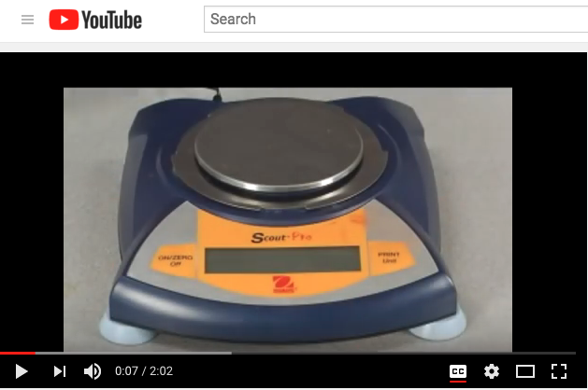
Exp. 1 – Metric Measurement
Mass Measurement with an Electronic Balance:
https://www.youtube.com/watch?v=QtnPiKSKKtI

Slide 12
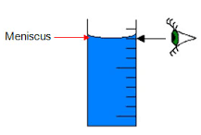
Exp. 1 – Metric Measurement
Volume Measurement (Liquids)
Measure at the bottom of the meniscus at eye level
Measurements with a Graduated Cylinder:

Slide 13
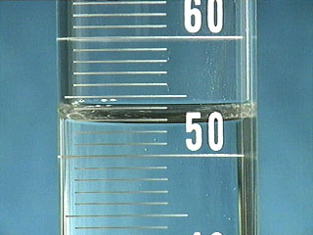
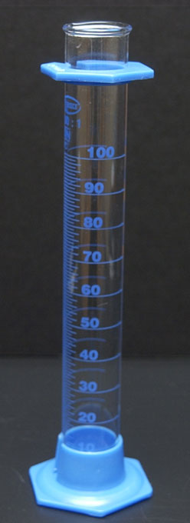
Exp. 1 – Metric Measurement
Measurement with a 100 mL Graduated Cylinder:
meniscus
52.9 mL
bottom of the meniscus at eye level
Take out the cylinder; pour some water into it.
Report this measurement as?
What is the volume of water in your cylinder?

Slide 14
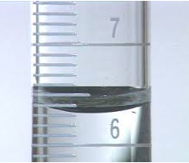
Exp. 1 – Metric Measurement
Measurement with a 10 mL Graduated Cylinder:
6.31 mL
Measure at the bottom of the meniscus at eye level
meniscus
Report this measurement as?

Slide 15
Exp. 1 – Metric Measurement
Important to record measurements to the correct limits of the equipment used (i.e. uncertainty/significant figures). NOTE: For this experiment the uncertainty limits (+/−) of the equipment is to be included.
Uncertainty limits are not normally included in calculations but are inferred from the correctly reported significant figure in the experimental value.
Estimating to 6.30 mL is ok if the meniscus is viewed to be exactly on the mark.
Estimating to 6.31 mL is also ok if the meniscus is viewed to be off the mark.
Report: 6.30 +/- 0.01 mL
Report: 6.31 +/- 0.01 mL

Slide 16
Exp. 1 – Metric Measurement
Measurement with a Graduated Cylinder:
Notice the difference in precision (uncertainty) with each instrument used and their maximum capacities
100 mL Graduated Cylinder
10 mL Graduated Cylinder
Measurement: 52.9 +/− 0.1mL
Measurement: 6.31 +/− 0.01mL

Slide 17
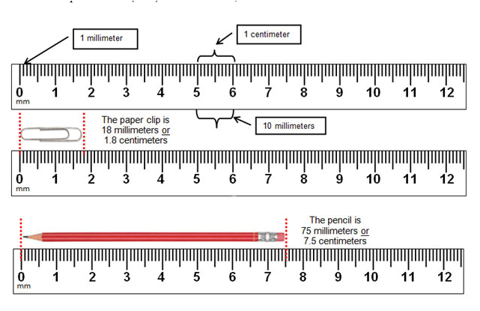
Exp. 1 – Metric Measurement
Measurement with a centimeter/millimeter ruler (Length)
Reported as: 75.0 +/- 0.1 mm or 7.50 +/- 0.01 cm

Slide 18
Exp. 1 – Metric Measurement
When measuring glassware with the ruler, use inner diameter of glassware, NOT outer diameter. Why?
Experimental error will occur:
  When pouring water out of test tube into graduated cylinder, some is always left in test tube; how does this systematic error affect accuracy of measured volume?
  Is the beaker a perfect cylinder?
  Think about how equipment and handling; relate this to measurements and “systematic” errors.
  “Human Error” is NOT acceptable error.

Slide 19
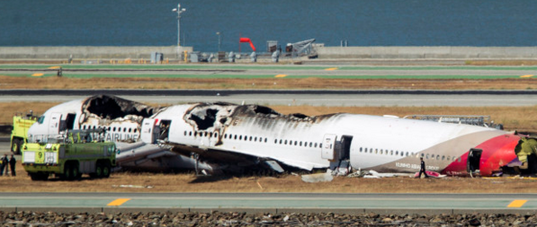
Exp. 1 – Metric Measurement
  “Human Error” is NOT acceptable in scientific measurements……. as in aeronautics.
SFO July 6, 2013

Slide 20
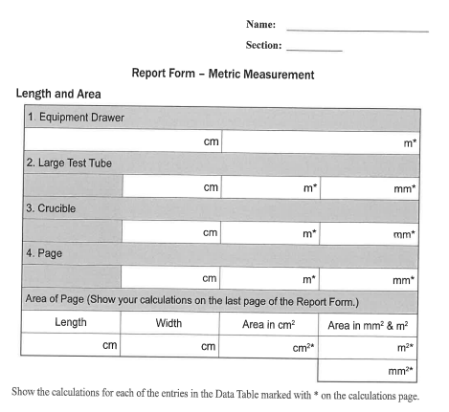
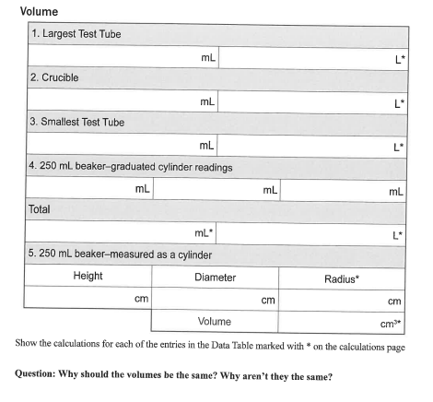
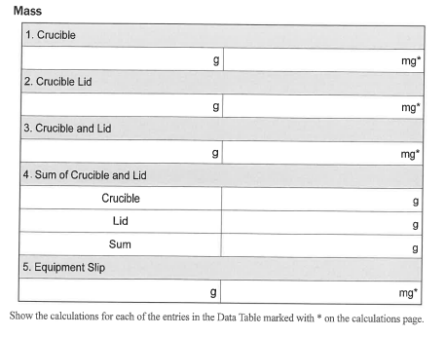
Experiment 1 – Metric Measurement
Complete and record all measurements today.
Conversions and calculations due next lab.

Slide 21
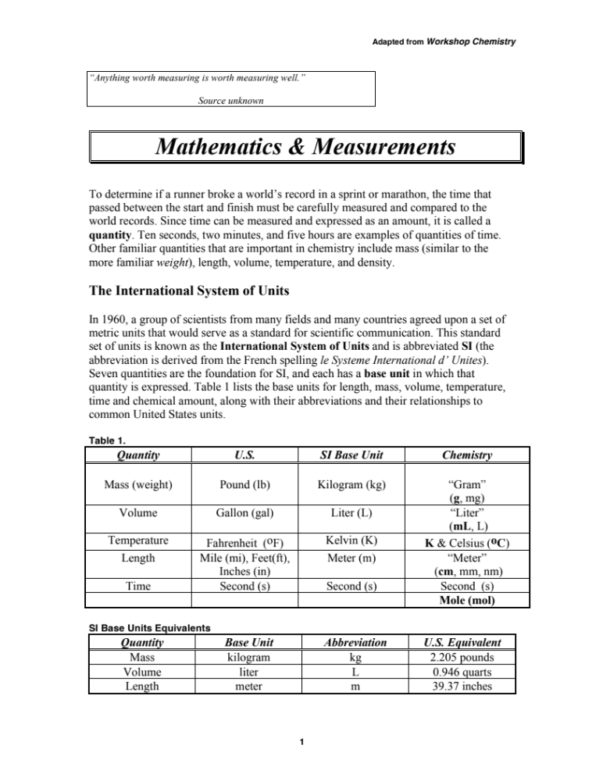
Reading (Handout)
http://chemconnections.org/general/chem108/Math%20%26%20Measurement-2018.pdf

Slide 22
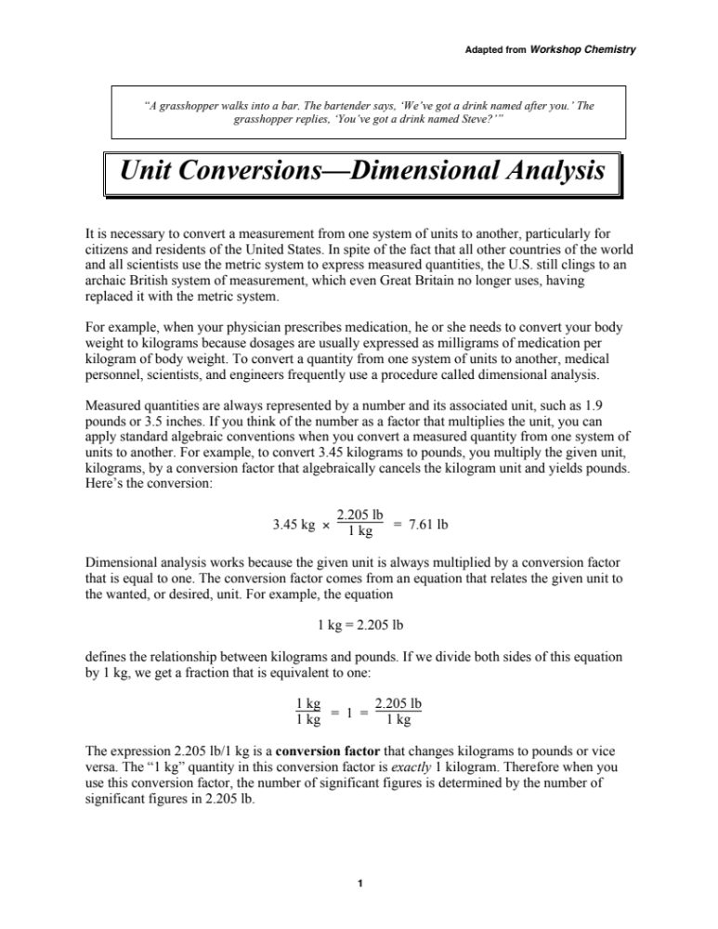
Reading (Handout)
http://chemconnections.org/general/chem108/WKS%20Reading%20Unit%20Conversion%20-%20Dimensional%20A.pdf

Slide 23
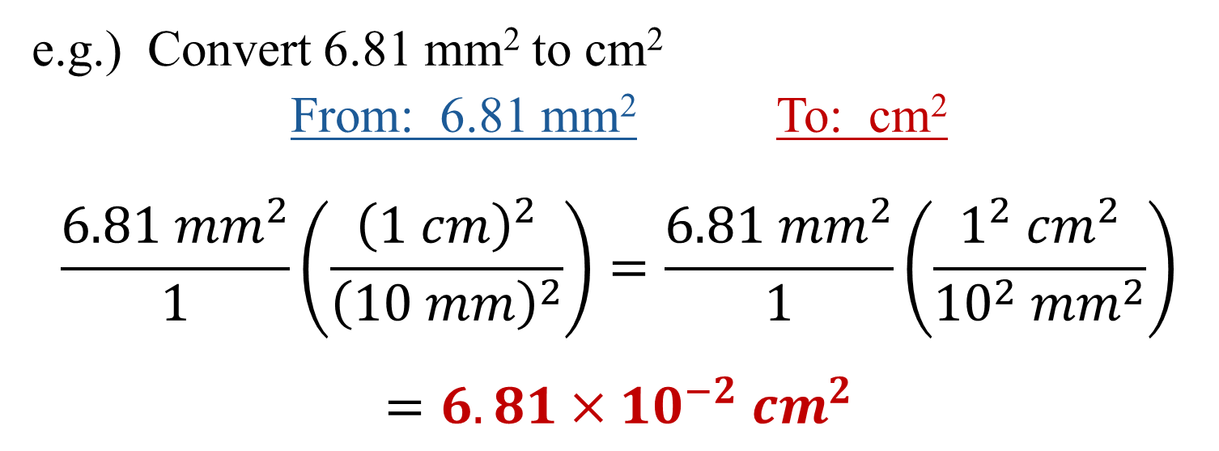

Converting squared or cubic units
When using linear factors conversion factors to “square” or “cube” be sure to square or cube the factor
10 mm = 1 cm

Slide 24
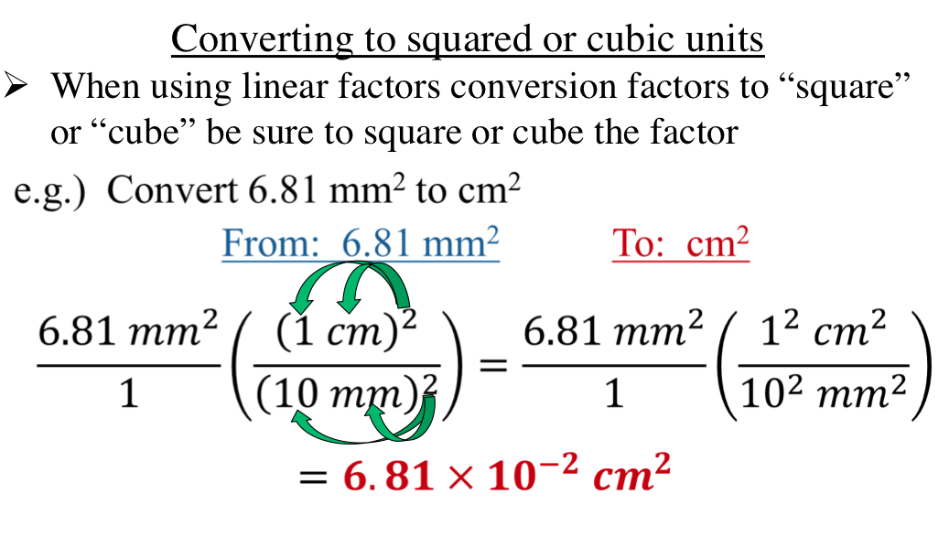
10 mm = 1 cm

Slide 25
Experiment 1 – Metric Measurement
Complete and record all measurements today.
Have Dr. R. sign individual forms before leaving lab today.
Only your measurement data is due to be signed today.
Conversions and calculations due next lab.

Slide 26
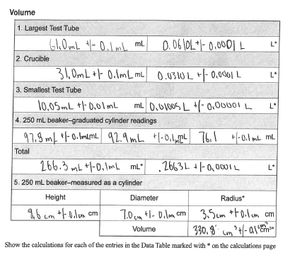
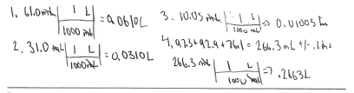
Exp. 1 – Metric Measurement
Example of an acceptable set of student data, conversions, and calculations.
DO NOT COPY.
Use as a guide.

Slide 27
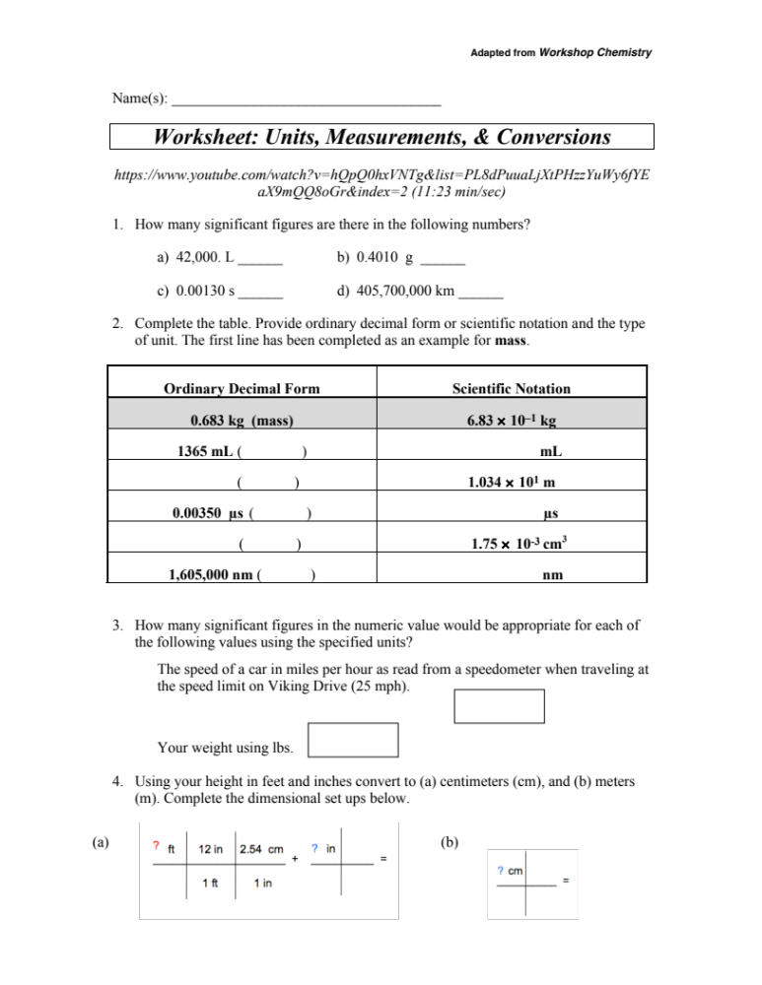
Worksheet (Handout): Due next lab. Collaboration is encouraged.
Turn in one with the names of all contributors.
http://chemconnections.org/general/chem108/Math%20%26%20Measurements-WKS.f18.pdf

Slide 28
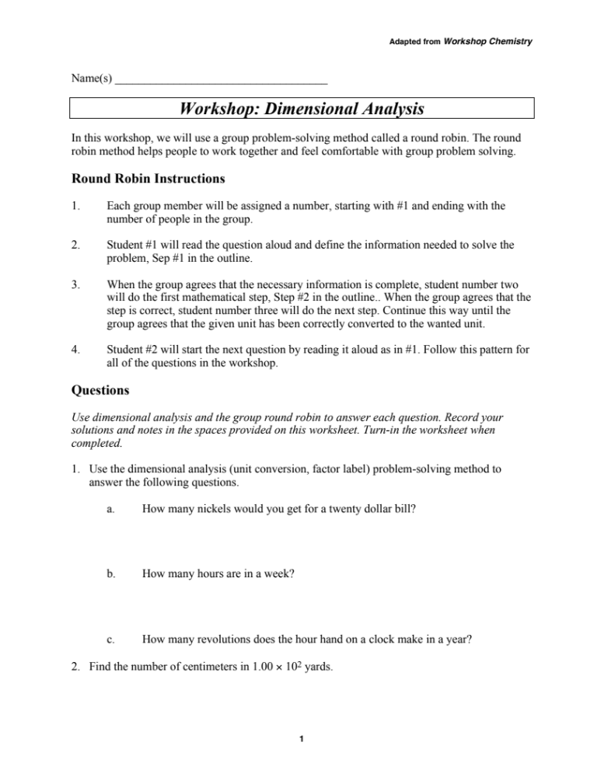
OPTIONAL: Chem 120, General Chemistry Level
Workshop/ Worksheet (Handout) http://chemconnections.org/general/chem108/WKS%20Unit%20Conversion%20-%20Dimensional%20A.pdf
Answers will not be provided; see Dr. R. with any questions after attempting the Worksheet’s problems

